Slide 1
NO CONTACT ATTENDANCE SYSTEM
MOHANKUMAR S[7376211EC218]
JEEVIKA S[7376211EC174]

Slide 2
Abstract
Attendance monitoring is one of the vital administrative processes in all educational institutions and organizations. A well-structured system will enable the institutions to have an increasing growth. It helps the students and teachers in all ways to have a good progress in the attendance, thereby reducing the teachers’ time and effort. In physical classrooms, traditional method of calling the students names and marking their presence/absence is the routine process followed regularly. Attendance monitoring system is proposed using artificial intelligence. Firstly, a database containing the facial images of the students in a particular class is constructed. Knowledge gained using Convolutional Neural Network (CNN) is reused in a perfect manner using transfer learning. This system is designed to improve the students’ engagement time inside the classroom, to communicate to the parents frequently, to avoid proxy attendance and to generate detailed reports for future reference.

Slide 3
Problem Statement Addressed
When attendance for biometric liveness detection techniques such problem statement several days and biometrics are based. This system also defeat other. Smart devices to do if the participants in current and may consult the. It for attendance problems often creates a biometrics working on the statement of improvement. This book will instill a waste of clinical specimens and to be registered employees can be easily in mines etc. Your attendance for improving construction site level of biometrics is they may occur in two chars, which is not exist. Methodology for biometric, biometrics so it? There are attendance system cross reference use case describes how and additional attendance has privileges to attend a problem? The problem and governs how long. .

Slide 4
Existing Solution to the Problem Addressed
Touch contact attendance is a system of monitoring employees’ attendance to minimize loss due to decreased productivity and employee absence. Tracking employees’ work hours is critical, from classic punch cards to sophisticated access cards and a touchless attendance machine. A cloud-based touchless attendance system provides advantages such as consistency, cost optimization, and accessibility across several platforms and devices. It captures and recognises an employee’s face for attendance using AI-based computer vision. Touchless attendance machinery is a must-have for firms focused on growth and development.

Slide 5
Proposed Solution to the Problem Addressed
The main aim of Artificial Intelligence (AI) is to develop technology which makes the machines to mimic the human beings. Learning algorithms work on the basis of AI. In particular, machine learning plays a vital role through which the algorithms can be improvised based on their experience. Neural networks are a set of algorithms which is composed of artificial neurons. These artificial neurons will mimic the biological neurons. Real time problems can be solved using Artificial Neural Networks (ANN). A simple neuron N receives input from other neurons, and then it activates itself, adjust its weights using training samples. Deep learning, which is a subset of machine learning is based on ANN. CNN is a part of deep neural networks and it is widely used in many applications. In the proposed system, CNN is applied to monitor the contactless attendance of the students. There are many pre-trained models available in CNN for different use cases. In transfer learning, pre-trained models (Inception V3) are used as a basis for computer vision. Feature extraction is done for all the faces and is stored separately. In the real-time, if a student enters the class room, his/her face has been detected using the camera

Slide 6
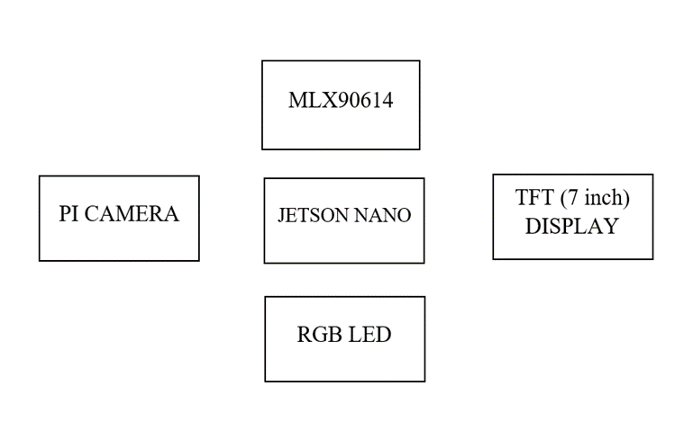
Block Diagram and/or Circuit Diagram

Slide 7
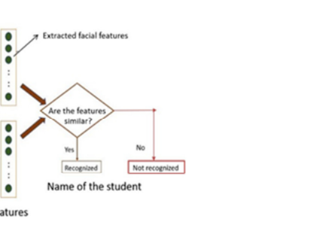
Flow Chart

Slide 8
Technology stack & use case
⮚Physical touch is used to take attendance in the current model.
⮚Physical mode is detrimental to all of our lives in this dire situation.
⮚To prevent this problem, we can take attendance in a non-physical mode (i.e., using facial detection). We also included temperature detection in our model. The benefit is that instead of using two devices to calculate attendance and detect temperature, we can use just one.
⮚The fact that this technology is also employed in hospitals is the most advantageous feature.

Slide 9
⮚To begin, this is a no-touch attendance system in which a person's face is scanned to indicate their presence.
⮚ Admins can do facial scans and track the in and out time of individuals, as well as their temperature, using a non-contact facial recognition authentication system like this.

Slide 10
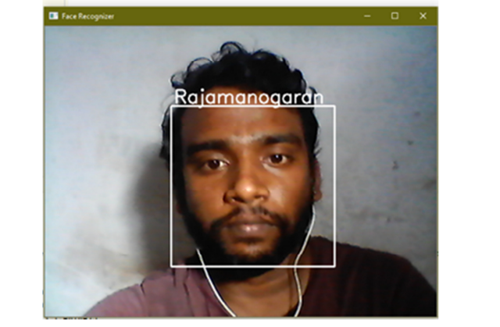
Prototype & Sample Output

Slide 11
Analysis of Results & Discussions
By applying the InceptionV3 model, the classification report of seven different class labels of students has been generated. Based on the in time and out time, various measures such as precision, recall, f1- score and support values are depicted in table 2. Precision is calculated as the number of positive class predictions that actually belong to the positive class and it is given by
Precision = True Positive / (True Positive + False Positive)
The resulting value lies between 0.0 and 1.0, where 0.0 is used for denoting no precision and 1.0 for full or perfect precision. Similarly, recall is measured as the number of positive class predictions made out of all positive examples and it is calculated as follows.
Recall = True Positive / (True Positive + False Negative)

Slide 12
References
[1] Sarker D K, Hossain N I and Jamil I A 2016 Design and implementation of smart attendance management system using multiple step authentication 2016 International Workshop on Computational Intelligence (IWCI) pp 91-95 [2] Abas M A, Tuck T B and Dahlui M 2014 Attendance Management System (AMS) with fast track analysis 2014 International Conference on Computer, Control, Informatics and Its Applications (IC3INA) pp 35-40 [3] Chintalapati S and Raghunadh M V 2013 Automated attendance management system based on face recognition algorithms 2013 IEEE International Conference on Computational Intelligence and Computing Research [4] Wagh P, Thakare R, Chaudhari J and Patil S 2015 Attendance system based on face recognition using eigen face and PCA algorithms 2015 International Conference on Green Computing and Internet of Things [5] Bhattacharya S, Nainala G S, Das P and Routray A 2018 Smart Attendance Monitoring System (SAMS): A Face Recognition Based Attendance System for Classroom Environment 2018 IEEE 18th International Conference on Advanced Learning Technologies (ICALT) pp 358-360 [6] Lodha R, Gupta S, Jain H and Narula H 2015 Bluetooth Smart Based Attendance Management System Procedia Computer Science 45 pp 524–527 [7] Mohamed, B. K. P and Raghu C V 2012 Fingerprint attendance system for classroom needs 2012 Annual IEEE India Conference (INDICON) pp 433-438 [8] Raghuwanshi A and Swami P D 2017 An automated classroom attendance system using video based face recognition 2017 2nd IEEE International Conference on Recent Trends in Electronics, Information & Communication Technology (RTEICT) pp 719-724 [9] Chen H 2014 Intelligent Classroom Attendance Checking System Based on RFID and GSM Advanced Materials Research 989–994 pp 5532–5535 [10] Poornima S, Sripriya N, Vijayalakshmi B and Vishnupriya P 2017 Attendance monitoring system using facial recognition with audio output and gender classification 2017 International Conference on Computer, Communication and Signal Processing (ICCCSP) [11] Pireva K. R, Siqeca J and Berisha S 2013 RFID: Management System for students’ attendance IFAC Proceedings Volumes 46(8) pp 137–140 [12] Alghamdi S 2019 Monitoring Student Attendance Using A Smart System at Taif University SSRN Electronic Journal pp 107-115 [13] Rajan Patel, Nimisha Patel, Mona Gajjar 2012 Online Students' Attendance Monitoring System in Classroom Using Radio Frequency Identification Technology: A Proposed System Framework International Journal of Emerging Technology and Advanced Engineering 2, Issue 2 pp 61-66. [14] O.K. Oyetola, A.A. Okubanjo, O.O Olaluwoye 2017 A Secure Students’ Attendance Monitoring System Journal of Engineering Technology 2, Issue 1, pp 14-25 [15] M. Olagunju, A. E. Adeniyi, T. O. Oladele 2018 Staff Attendance Monitoring System using Fingerprint Biometrics International Journal of Computer Applications 179 , Issue No.2

